Slide 1
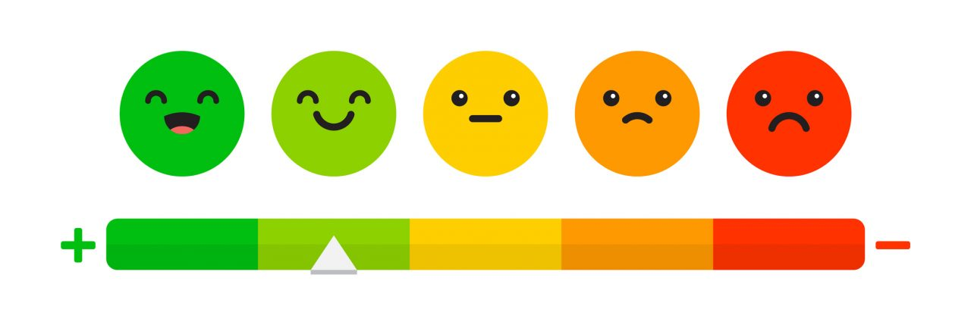
How happy are we?
Happiness score comparison across the globe

Slide 2
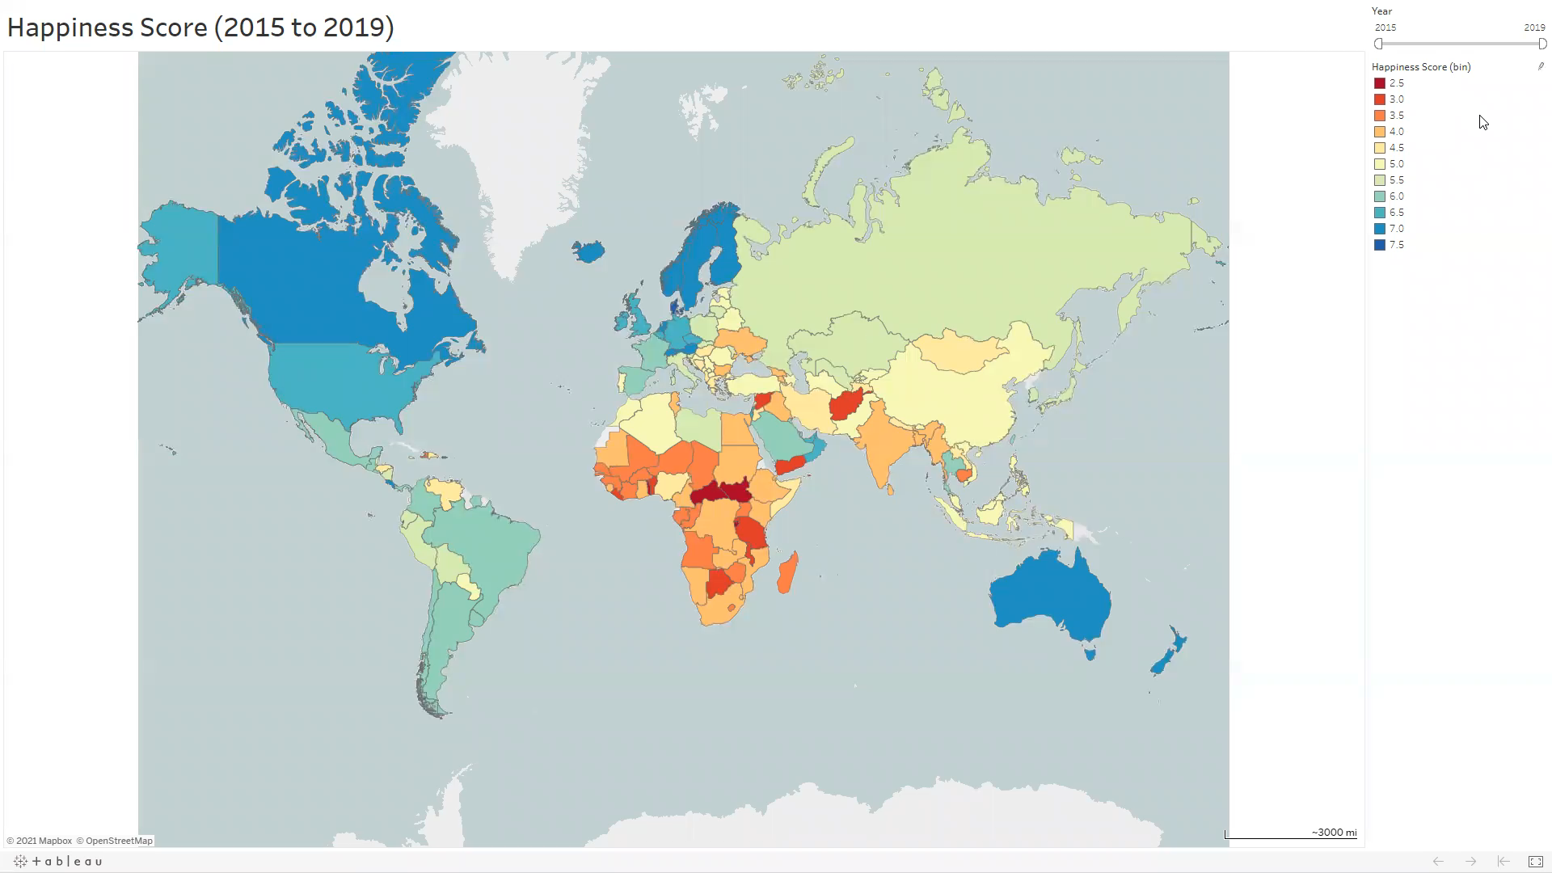
Happiness Score Interactive Map

Slide 3
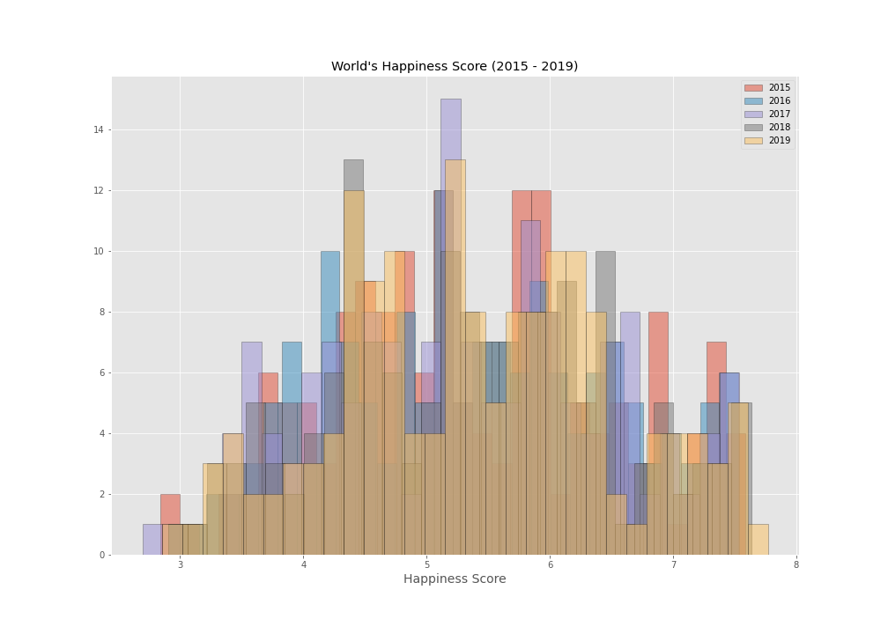
Insights
Overall distribution remained the same over time.
Slight increase as years pass.

Slide 4
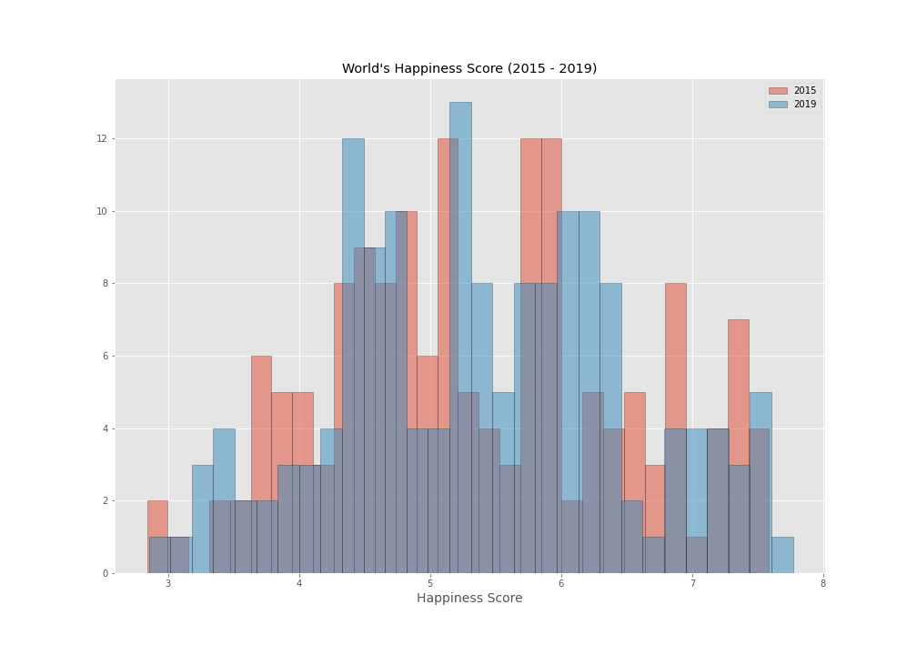
Insights
Comparing the 2019 and 2015 happiness scores, we can clearly see the modes of the distribution shift towards higher scores.
This could possibly indicate that the world is getting happier?

Slide 5
Sub-Saharan Africa, with countries most stricken by poverty, reported the highest increase in happiness scores within 5 years.
North America comprising of the two richest nations in the world reported the highest decrease in happiness around the world.

Slide 6
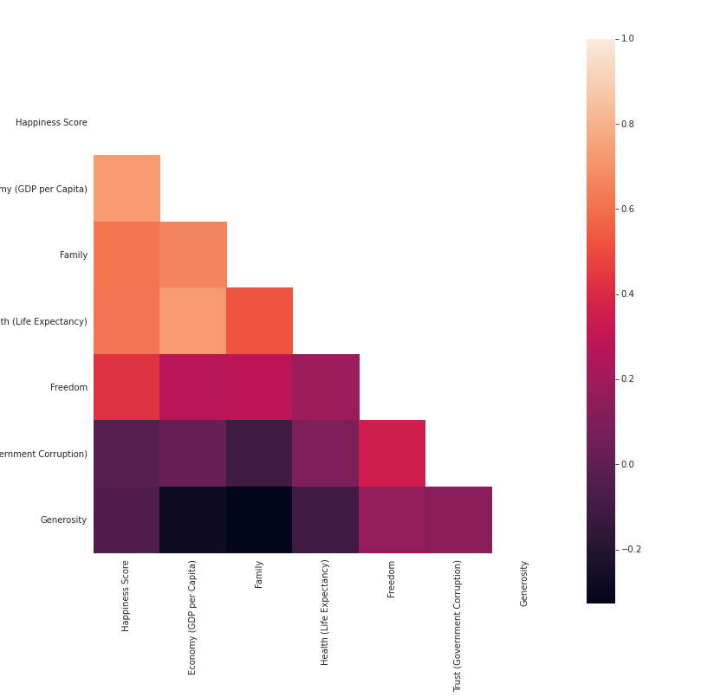
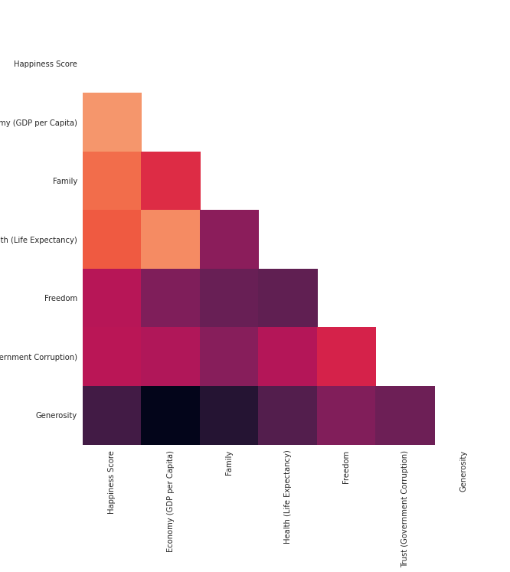
Sub-Saharan Africa Region
2015
2019
Insights
GDP is positively correlated with happiness, along with Family, Life Expectancy, and Freedom.
Perception of government corruption and generosity tend to have the opposite effect on happiness.

Slide 7
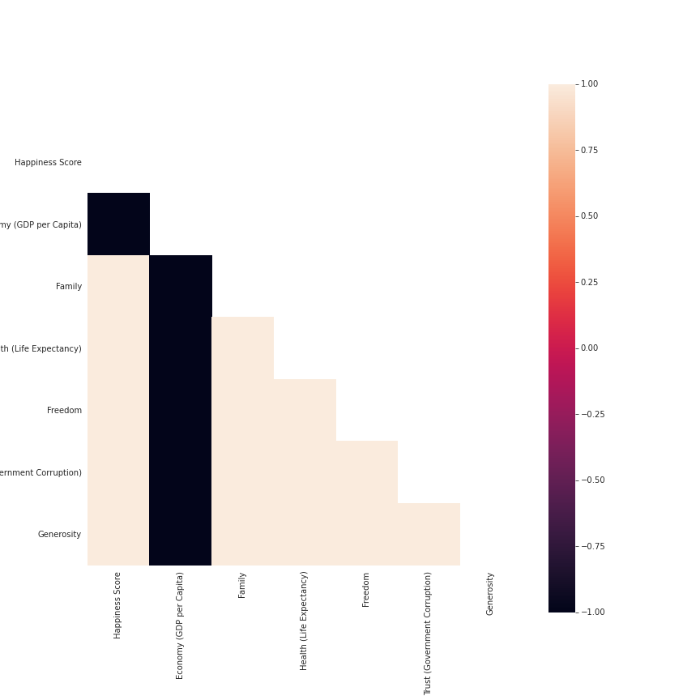
Sub-Saharan Africa Region
2015
2019
Insights
GDP is negatively affecting happiness. This can be a sign of the uneven distribution of wealth in the US.
GDP is negatively correlated with all other factors considered in people’s happiness.
Note: Extreme correlation results due to the number of countries in North America.

Slide 8
Comparison between richest country in North America and poorest country in Sub-Saharan Africa
0.1%
2.1%
Insights
Consistent decrease of happiness in the US since 2015.
Nigeria is consistently increasing in happiness since 2016.
Similar GDP performance trend between the US and Nigeria, with Nigeria operating at a lower level.

Slide 9
Comparison between richest country in North America and poorest country in Sub-Saharan Africa
6.7%
410%
Insights
Life expectancy is a lot lower in Nigeria compared to US.
However, between 2018 and 2019 an increase of 410% occurred in the expected life expectancy in Nigeria.
Similar trends can be seen between the two countries when it comes to the perception of corruption and freedom in the respective countries.
There is a slight uptick in the perception of corruption in Nigeria in 2019.

Slide 10
References:
https://www.kaggle.com/unsdsn/world-happiness
https://www.newsweek.com/nigerias-2016-review-troubled-transformation-535654
https://storymaps.arcgis.com/stories/ad7fca0337024e7fa8e9d88cdf4ff158

